Slide 1
7.1 Eigenvalues And Eigenvectors

Slide 2
Definition
If A is an n×n matrix, then a nonzero vector x in R^{n} is called an eigenvector of A if Ax is a scalar multiple of x; that is,
Ax=λx
for some scalar λ. The scalar λ is called an eigenvalue of A, and x is said to be an eigenvector of A corresponding to λ.

Slide 3
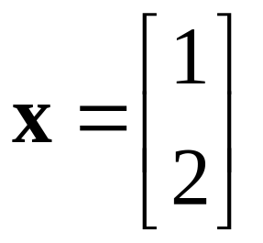
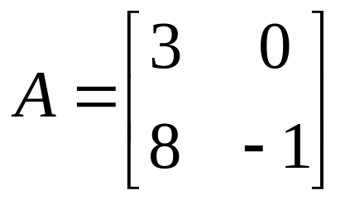
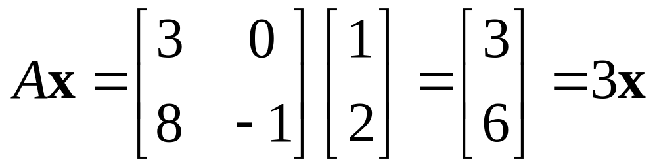
Example 1
Eigenvector of a 2×2 Matrix
The vector is an eigenvector of
Corresponding to the eigenvalue λ=3, since

Slide 4
To find the eigenvalues of an n×n matrix A we rewrite Ax=λx as
Ax=λIx
or equivalently,
(λI-A)x=0 (1)
For λ to be an eigenvalue, there must be a nonzero solution of this equation. However, by Theorem 6.4.5, Equation (1) has a nonzero solution if and only if
det (λI-A)=0
This is called the characteristic equation of A; the scalar satisfying this equation are the eigenvalues of A. When expanded, the determinant det (λI-A) is a polynomial p in λ called the characteristic polynomial of A.

Slide 5
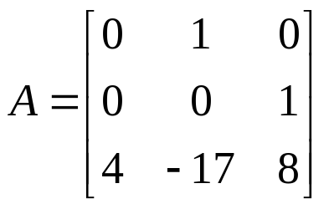
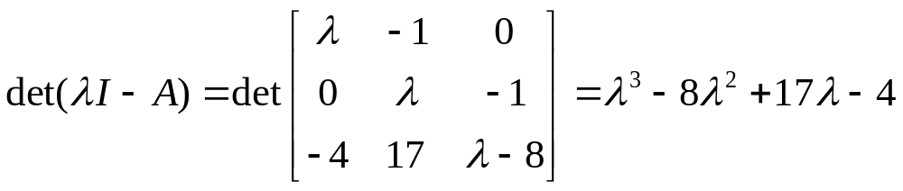
Example 2
Eigenvalues of a 3×3 Matrix (1/3)
Find the eigenvalues of
Solution.
The characteristic polynomial of A is
The eigenvalues of A must therefore satisfy the cubic equation

Slide 6
Example 2
Eigenvalues of a 3×3 Matrix (2/3)
To solve this equation, we shall begin by searching for integer solutions. This task can be greatly simplified by exploiting the fact that all integer solutions (if there are any) to a polynomial equation with integer coefficients
λ^{n}+c₁λ^{n-1}+…+c_{n}=0
must be divisors of the constant term c_{n}. Thus, the only possible integer solutions of (2) are the divisors of -4, that is, ±1, ±2, ±4. Successively substituting these values in (2) shows that λ＝4 is an integer solution. As a consequence, λ-4 must be a factor of the left side of (2). Dividing λ-4 into λ³-8λ²+17λ-4 show that (2) can be rewritten as
(λ-4)(λ²-4λ+1)=0

Slide 7
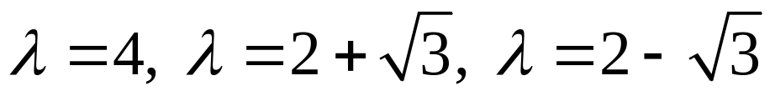
Example 2
Eigenvalues of a 3×3 Matrix (3/3)
Thus, the remaining solutions of (2) satisfy the quadratic equation
λ²-4λ+1=0
which can be solved by the quadratic formula. Thus, the eigenvalues of A are

Slide 8
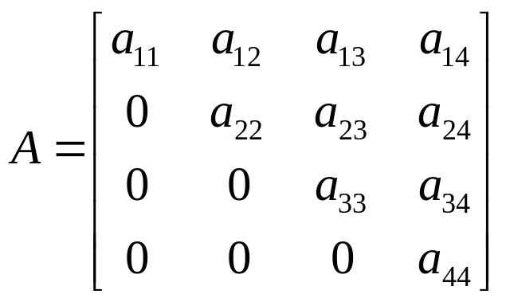
Example 3
Eigenvalues of an Upper Triangular Matrix (1/2)
Find the eigenvalues of the upper triangular matrix
Solution.
Recalling that the determinant of a triangular matrix is the product of the entries on the main diagonal (Theorem 2.2.2), we obtain

Slide 9
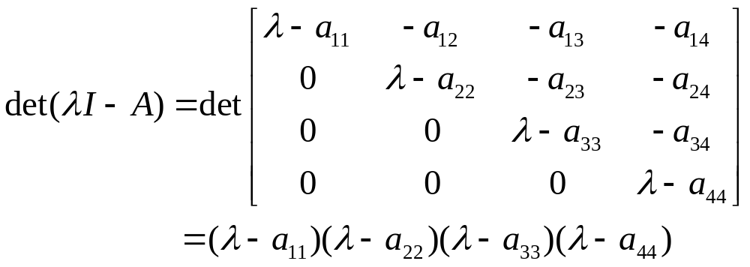
Example 3
Eigenvalues of an Upper Triangular Matrix (2/2)
Thus, the characteristic equation is
(λ-a₁₁)(λ-a₂₂) (λ-a₃₃) (λ-a₄₄)=0
and the eigenvalues are
λ=a₁₁, λ=a₂₂, λ=a₃₃, λ=a₄₄
which are precisely the diagonal entries of A.

Slide 10
Theorem 7.1.1
If A is an n×n triangular matrix (upper triangular, low triangular, or diagonal), then the eigenvalues of A are entries on the main diagonal of A.

Slide 11
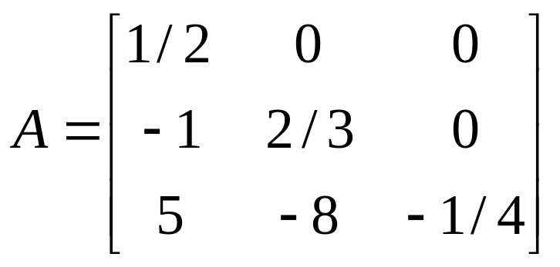
Example 4
Eigenvalues of a Lower Triangular Matrix
By inspection, the eigenvalues of the lower triangular matrix
are λ=1/2, λ=2/3, and λ=-1/4.

Slide 12
Theorem 7.1.2
Equivalent Statements
If A is an n×n matrix and λ is a real number, then the following are equivalent.
λ is an eigenvalue of A.
The system of equations (λI-A)x=0 has nontrivial solutions.
There is a nonzero vector x in R^{n} such that Ax=λx.
λ is a solution of the characteristic equation det(λI-A)=0.

Slide 13
Finding Bases for Eigenspaces
The eigenvectors of A corresponding to an eigenvalue λ are the nonzero x that satisfy Ax=λx. Equivalently, the eigenvectors corresponding to λ are the nonzero vectors in the solution space of (λI-A)x=0. We call this solution space the eigenspace of A corresponding to λ.

Slide 14
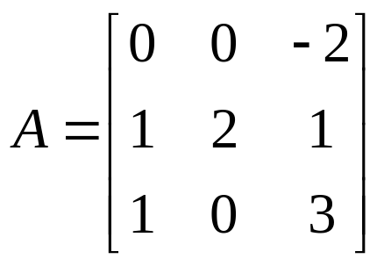
Example 5
Bases for Eigenspaces (1/5)
Find bases for the eigenspaces of
Solution.
The characteristic equation of matrix A is λ³-5λ²+8λ-4=0, or in factored form, (λ-1)(λ-2)²=0; thus, the eigenvalues of A are λ=1 and λ=2, so there are two eigenspaces of A.

Slide 15
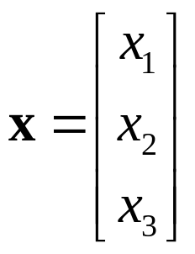
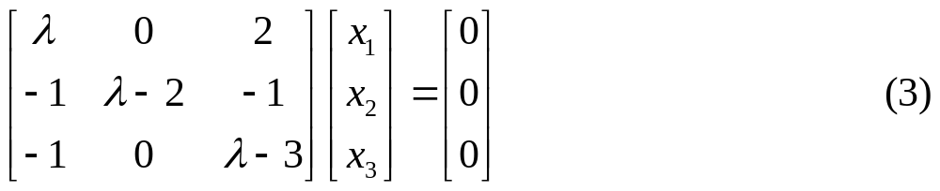
Example 5
Bases for Eigenspaces (2/5)
By definition,
Is an eigenvector of A corresponding to λ if and only if x is a nontrivial solution of (λI-A)x=0, that is, of
If λ=2, then (3) becomes

Slide 16
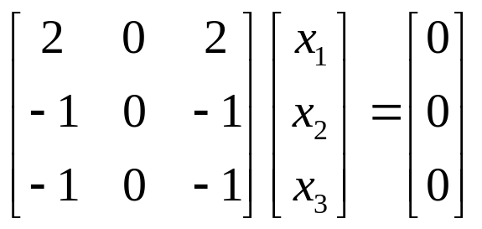
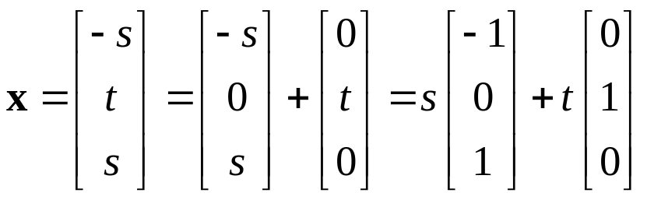
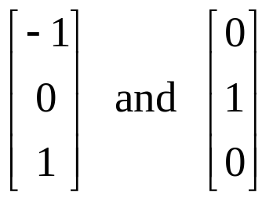
Example 5
Bases for Eigenspaces (3/5)
Solving this system yield
x₁=-s, x₂=t, x₃=s
Thus, the eigenvectors of A corresponding to λ=2 are the nonzero vectors of the form
Since

Slide 17
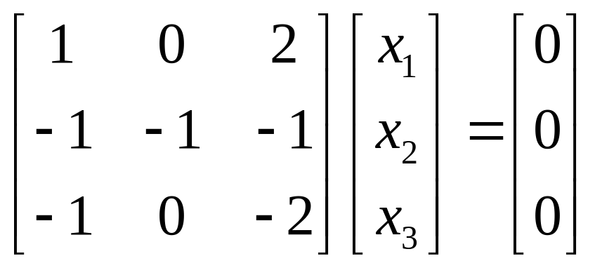
Example 5
Bases for Eigenspaces (4/5)
are linearly independent, these vectors form a basis for the eigenspace corresponding to λ＝2.
If λ＝1, then (3) becomes
Solving this system yields
x₁=-2s, x₂=s, x₃=s

Slide 18
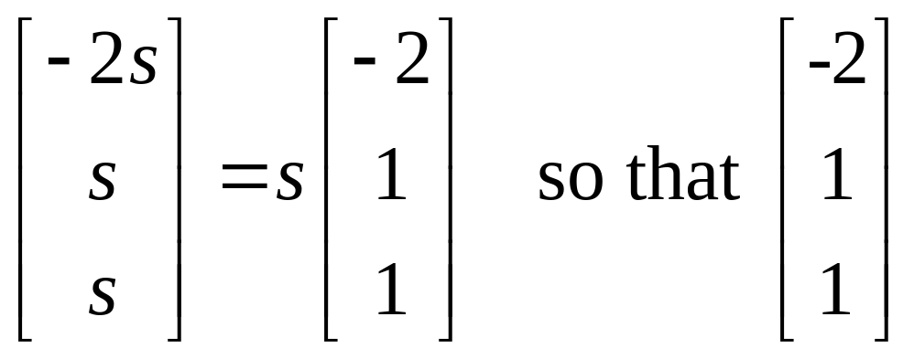
Example 5
Bases for Eigenspaces (5/5)
Thus, the eigenvectors corresponding to λ＝1 are the nonzero vectors of the form
is a basis for the eigenspace corresponding to λ＝1.

Slide 19
Theorem 7.1.3
If k is a positive integer, λ is an eigenvalue of a matrix A, and x is corresponding eigenvector, then λ^{k} is an eigenvalue of A^{k} and x is a corresponding eigenvector.

Slide 20
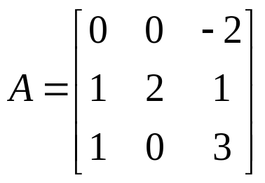
Example 6
Using Theorem 7.1.3 (1/2)
In Example 5 we showed that the eigenvalues of
are λ=2 and λ=1, so from Theorem 7.1.3 both λ=2⁷=128 and λ=1⁷=1 are eigenvalues of A⁷. We also showed that
are eigenvectors of A corresponding to the eigenvalue λ=2, so from Theorem 7.1.3 they are also eigenvectors of A⁷ corresponding to λ=2⁷=128. Similarly, the eigenvector

Slide 21
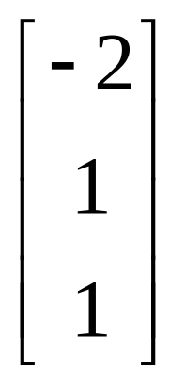
Example 6
Using Theorem 7.1.3 (2/2)
of A corresponding to the eigenvalue λ=1 is also eigenvector of A⁷ corresponding to λ=1⁷=1.

Slide 22
Theorem 7.1.4
A square matrix A is invertible if and only if λ=0 is not an eigenvalue of A.

Slide 23
Example 7
Using Theorem 7.1.4
The matrix A in Example 5 is invertible since it has eigenvalues λ=1 and λ=2, neither of which is zero. We leave it for reader to check this conclusion by showing that det(A)≠0

Slide 24
Theorem 7.1.5
Equivalent Statements (1/3)
If A is an n×n matrix, and if T_{A}: R^{n} →R^{n} is multiplication by A, then the following are equivalent.
A is invertible.
Ax=0 has only the trivial solution.
The reduced row-echelon form of A is I_{n}.
A is expressible as a product of elementary matrix.
Ax=b is consistent for every n×1 matrix b.
Ax=b has exactly one solution for every n×1 matrix b.
det(A)≠0.

Slide 25
Theorem 7.1.5
Equivalent Statements (2/3)
The range of T_{A} is R^{n}.
T_{A} is one-to-one.
The column vectors of A are linearly independent.
The row vectors of A are linearly independent.
The column vectors of A span R^{n}.
The row vectors of A span R^{n}.
The column vectors of A form a basis for R^{n}.
The row vectors of A form a basis for R^{n}.

Slide 26
Theorem 7.1.5
Equivalent Statements (3/3)
A has rank n.
A has nullity 0.
The orthogonal complement of the nullspace of A is R^{n}.
The orthogonal complement of the row space of A is {0}.
A^{T}A is invertible.
λ=0 is not eigenvalue of A.

Slide 27
7.2 Diagonalization

Slide 28
Definition
A square matrix A is called diagonalizable if there is an invertible matrix P such that P⁻¹AP is a diagonal matrix; the matrix P is said to diagonalize A.

Slide 29
Theorem 7.2.1
If A is an n×n matrix, then the following are equivalent.
A is diagonalizable.
A has n linearly independent eigenvectors.

Slide 30
Procedure for Diagonalizing a Matrix
The preceding theorem guarantees that an n×n matrix A with n linearly independent eigenvectors is diagonalizable, and the proof provides the following method for diagonalizing A.
Step 1. Find n linear independent eigenvectors of A, say, p₁, p₂, …, p_{n}.
Step 2. From the matrix P having p₁, p₂, …, p_{n} as its column vectors.
Step 3. The matrix P⁻¹AP will then be diagonal with λ₁, λ₂, …, λ_{n} as its successive diagonal entries, where λ_{i} is the eigenvalue corresponding to p_{i}, for i=1, 2, …, n.

Slide 31

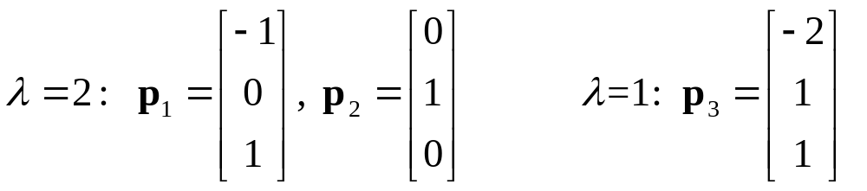
Example 1
Finding a Matrix P That Diagonalizes a Matrix A (1/2)
Find a matrix P that diagonalizes
Solution.
From Example 5 of the preceding section we found the characteristic equation of A to be
(λ-1)(λ-2)²=0
and we found the following bases for the eigenspaces:

Slide 32
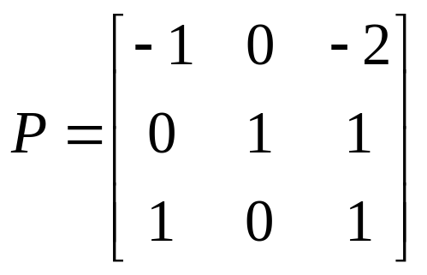
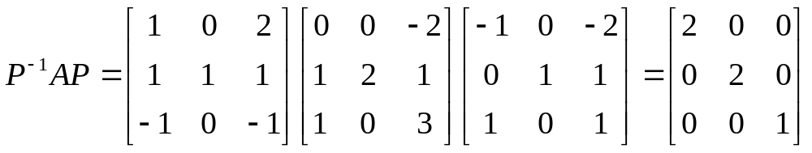
Example 1
Finding a Matrix P That Diagonalizes a Matrix A (2/2)
There are three basis vectors in total, so the matrix A is diagonalizable and
diagonalizes A. As a check, the reader should verify that

Slide 33
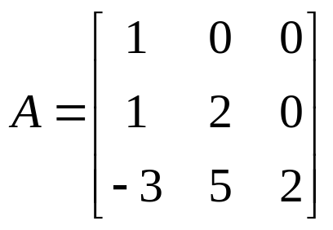
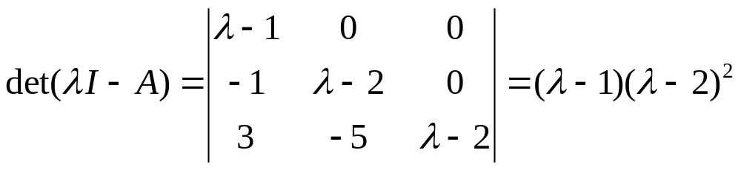
Example 2
A Matrix That Is Not Diagonalizable (1/4)
Find a matrix P that diagonalize
Solution.
The characteristic polynomial of A is

Slide 34
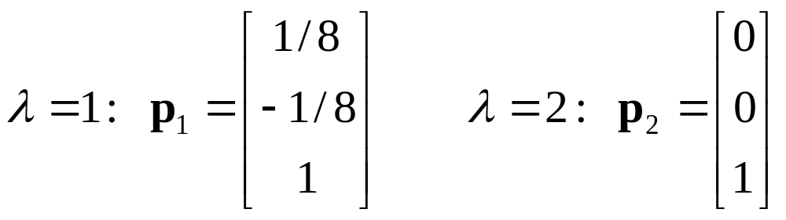
Example 2
A Matrix That Is Not Diagonalizable (2/4)
so the characteristic equation is
(λ-1)(λ-2)²=0
Thus, the eigenvalues of A are λ=1 and λ=2. We leave it for the reader to show that bases for the eigenspaces are
Since A is a 3×3 matrix and there are only two basis vectors in total, A is not diagonalizable.

Slide 35
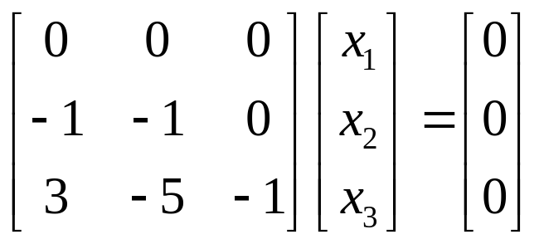
Example 2
A Matrix That Is Not Diagonalizable (3/4)
Alternative Solution.
If one is interested only in determining whether a matrix is diagonalizable and is not concerned with actually finding a diagonalizing matrix P, then it is not necessary to compute bases for the eigenspaces; it suffices to find the dimensions of the eigenspaces. For this example, the eigenspace corresponding to λ=1 is the solution space of the system
The coefficient matrix has rank 2. Thus, the nullity of this matrix is 1 by Theorem 5.6.3, and hence the solution space is one-dimensional.

Slide 36
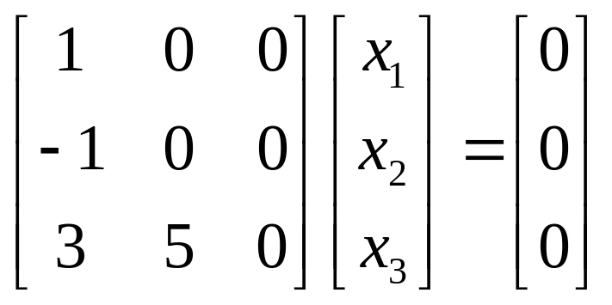
Example 2
A Matrix That Is Not Diagonalizable (4/4)
The eigenspace corresponding to λ=2 is the solution space system
This coefficient matrix also has rank 2 and nullity 1, so the eigenspace corresponding to λ=2 is also one-dimensional. Since the eigenspaces produce a total of two basis vectors, the matrix A is not diagonalizable.

Slide 37
Theorem 7.2.2
If v₁, v₂, … v_{k}, are eigenvectors of A corresponding to distinct eigenvalues λ₁, λ₂, …, λ_{k}, then{v₁, v₂, … v_{k}} is a linearly independent set.

Slide 38
Theorem 7.2.3
If an n×n matrix A has n distinct eigenvalues, then A is diagonalizable.

Slide 39
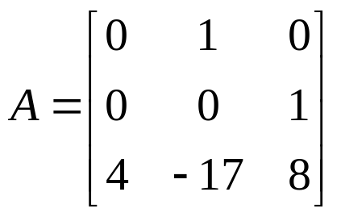

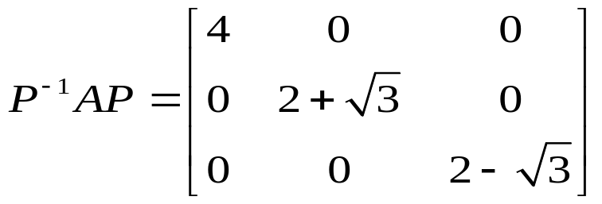
Example 3
Using Theorem 7.2.3
We saw in Example 2 of the preceding section that
has three distinct eigenvalues, . Therefore, A is diagonalizable. Further,
for some invertible matrix P. If desired, the matrix P can be found using method shown in Example 1 of this section.

Slide 40
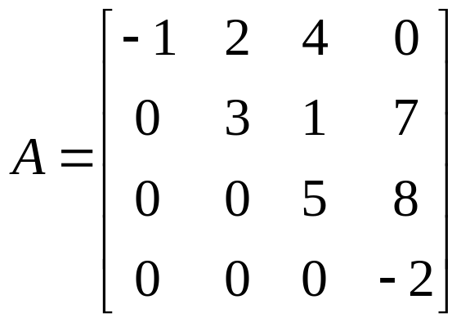
Example 4
A Diagonalizable Matrix
From Theorem 7.1.1 the eigenvalues of a triangular matrix are the entries on its main diagonal. This, a triangular matrix with distinct entries on the main diagonal is diagonalizable. For example,
is a diagonalizable matrix.

Slide 41
Theorem 7.2.4
Geometric and Algebraic Multiplicity
If A is a square matrix, then :
For every eigenvalue of A the geometric multiplicity is less than or equal to the algebraic multiplicity.
A is diagonalizable if and only if the geometric multiplicity is equal to the algebraic multiplicity for every eigenvalue.

Slide 42
Computing Powers of a Matrix (1/2)
There are numerous problems in applied mathematics that require the computation of high powers of a square matrix. We shall conclude this section by showing how diagonalization can be used to simplify such computations for diagonalizable matrices.
If A is an n×n matrix and P is an invertible matrix, then
(P⁻¹AP)²=P⁻¹APP⁻¹AP=P⁻¹AIAP=P⁻¹A²P
More generally, for any positive integer k
(P⁻¹AP)^{k}=P⁻¹A^{k}P (8)

Slide 43
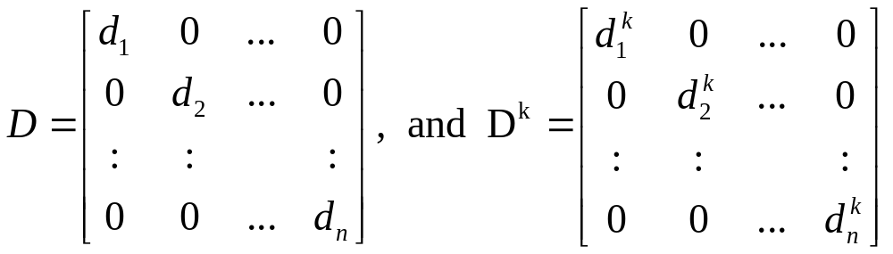
Computing Powers of a Matrix (2/2)
It follows form this equation that if A is diagonalizable, and P⁻¹AP=D is a diagonal matrix, then
P⁻¹A^{k}P=(P⁻¹AP)^{k}=D^{k} (9)
Solving this equation for A^{k} yields
A^{k}=PD^{k}P⁻¹ (10)
This last equation expresses the kth power of A in terms of the kth power of the diagonal matrix D. But D^{k} is easy to compute; for example, if

Slide 44

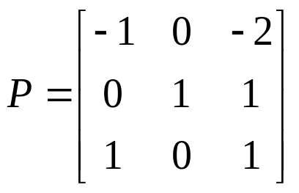
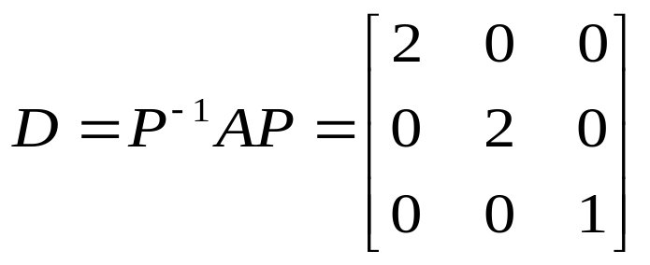
Example 5
Power of a Matrix (1/2)
Using (10) to find A¹³, where
Solution.
We showed in Example 1 that the matrix A is diagonalized by
and that

Slide 45
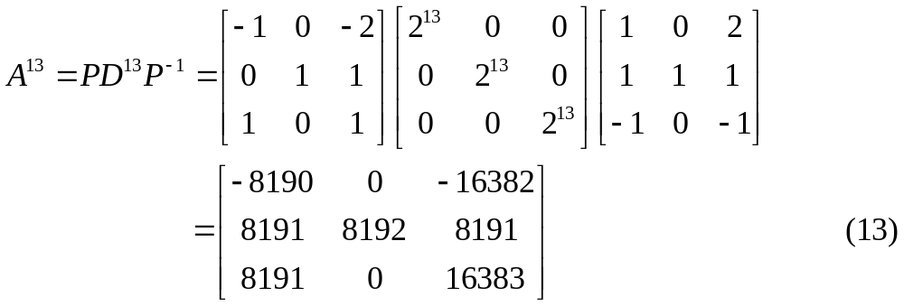
Example 5
Power of a Matrix (2/2)
Thus, form (10)

Slide 46
7.3 Orthogonal Diagonalization

Slide 47
The Orthogonal Diagonalization Matrix Form
Given an n×n matrix A, if there exist an orthogonal matrix P such that the matrix P⁻¹AP=P^{T}AP, then A is said to be orthogonally diagonalizable and P is said to orthogonally diagonalize A.

Slide 48
Theorem 7.3.1
If A is an n×n matrix, then the following are equivalent.
A is orthogonally diagonalizable.
A has an orthonormal set of n eigenvectors.
A is symmetric.

Slide 49
Theorem 7.3.2
If A is a symmetric matrix, then:
The eigenvalues of A are real numbers.
Eigenvectors from different eigenspaces are orthogonal.

Slide 50
Diagonalization of Symmetric Matrices
As a consequence of the preceding theorem we obtain the following procedure for orthogonally diagonalizing a symmetric matrix.
Step 1. Find a basis for each eigenspace of A.
Step 2. Apply the Gram-Schmidt process to each of these bases to obtain an orthonormal basis for each eigenspace.
Step 3. Form the matrix P whose columns are the basis vectors constructed in Step2; this matrix orthogonally diagonalizes A.

Slide 51
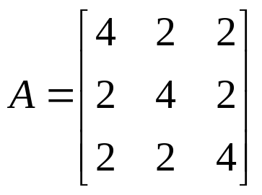
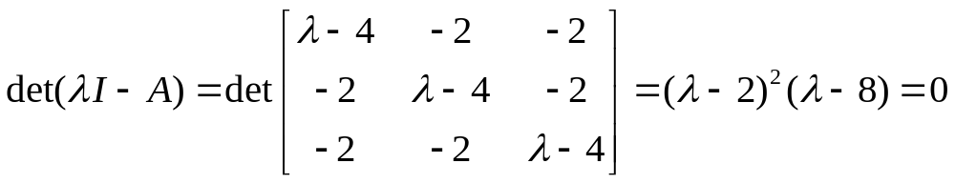
Example 1
An Orthogonal Matrix P That Diagonalizes a Matrix A (1/3)
Find an orthogonal matrix P that diagonalizes
Solution.
The characteristic equation of A is

Slide 52
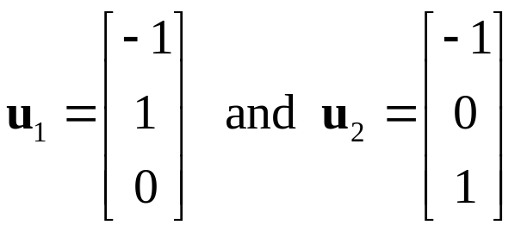
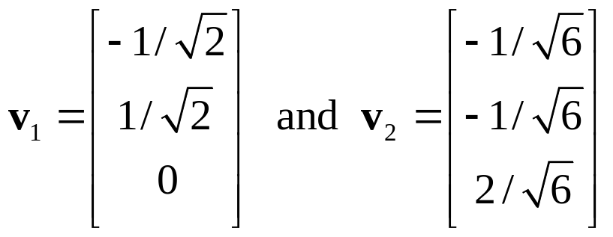
Example 1
An Orthogonal Matrix P That Diagonalizes a Matrix A (2/3)
Thus, the eigenvalues of A are λ=2 and λ=8. By the method used in Example 5 of Section 7.1, it can be shown that
form a basis for the eigenspace corresponding to λ=2. Applying the Gram-Schmidt process to {u₁, u₂} yields the following orthonormal eigenvectors:

Slide 53
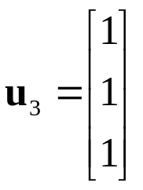
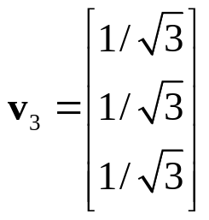
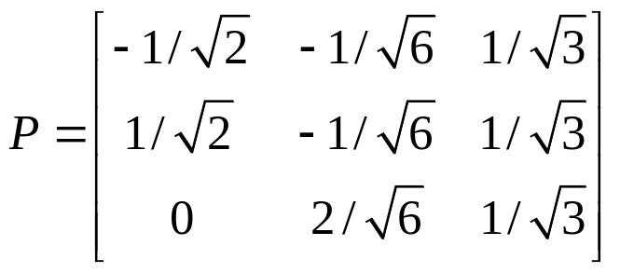
Example 1
An Orthogonal Matrix P That Diagonalizes a Matrix A (3/3)
The eigenspace corresponding to λ=8 has
as a basis. Applying the Gram-Schmidt process to {u₃} yields
Finally, using v1, v2, and v3 as column vectors we obtain
which orthogonally diagonalizes A.

